Slide 1

N Queen Problem
NarseGowda B M [221IT046]
Sagar Athani [221IT058]
Goutham Naik [221IT028]

Slide 2
Problem Statement
The N Queen Problem is a classic constraint satisfaction problem in computer science. The goal is to place N queens on an N×N chessboard such that no two queens can attack each other. This means no two queens can be in the same row, column, or diagonal.
1
Objective
2
Constraints
The goal is to find all possible configurations of N queens on a chessboard where no two queens can attack each other.
The placement of each queen must adhere to the rules of chess, ensuring no two queens occupy the same row, column, or diagonal.

Slide 3
Literature Survey
year
key finding on the paper
Techniques used
parameters analysed
research gap
2017
OpenMP with parallel loops, OpenMP with asynchronous tasks
Asynchronous tasks outperformed parallel loops in both speedup and execution time, with performance varying notably between compilers.
Execution time, speedup, and compiler differences (GCC, ICC, PGI)
The reasons for compiler-based performance differences are unclear; future research could investigate other benchmarks or platforms.

Slide 4
Literature Survey
Year
key finding on the paper
Techniques used
parameters analysed
research gap
2012
MPI-based recursive parallel algorithm for N-Queens problem
Optimized recursive parallel implementation significantly reduces computation time.
Feedback time (computation time) using different problem sizes (10, 11, 12, 13, etc.) and number of clients (up to 64)
Limited analysis on small problem sizes or excessive clients, indicating potential scalability issues.

Slide 5
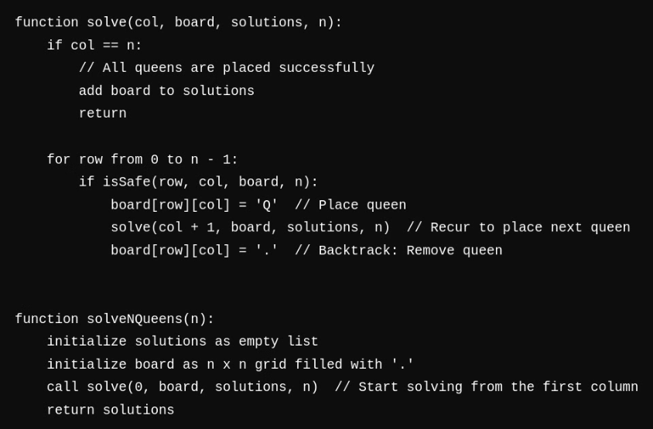
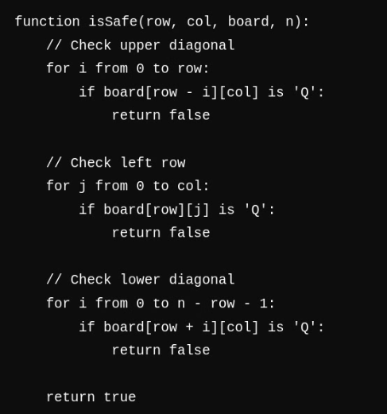
Sequential Pseudo Code

Slide 6
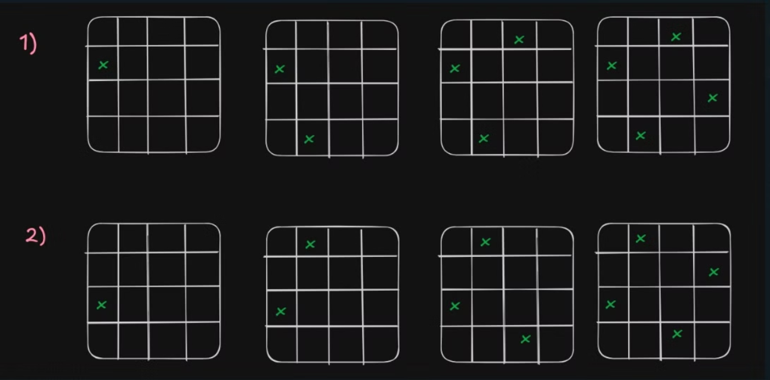
Output for n=4

Slide 7
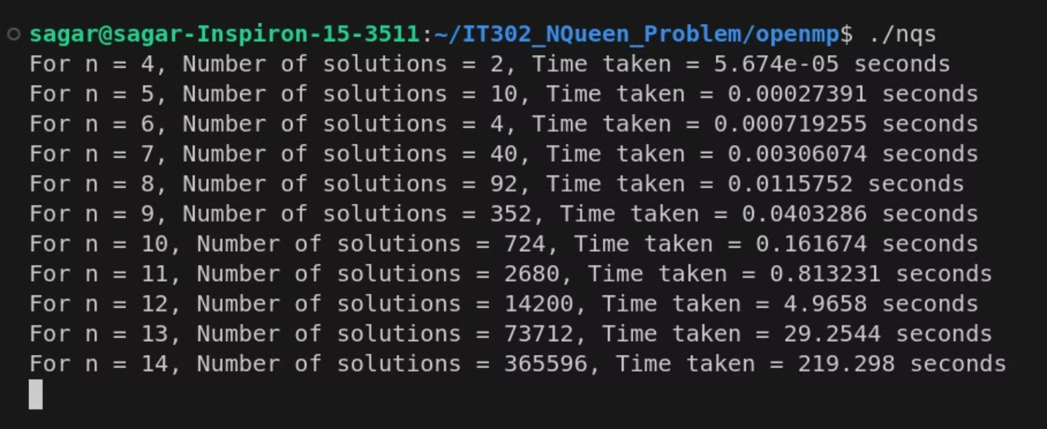
output for n=4 to n=15

Slide 8
Complexity
Time Complexity
Space Complexity
Backtracking explores all possible placements of queens, leading to O(n!) recursive calls
Board uses O(n^2) space for storing the queen placements.
Recursion Stack depth is O(n).
Safety checks for each queen take O(n) time
Overall Space Complexity: O(n^2).
Overall Time Complexity: O(n⋅n!)

Slide 9
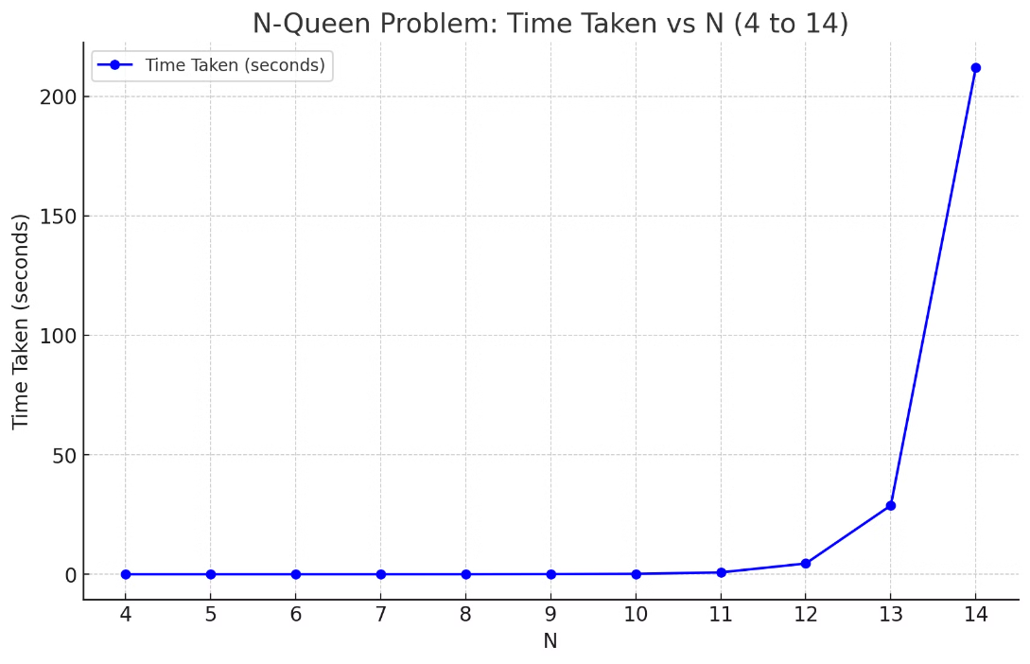
Time Taken Vs N

Slide 10
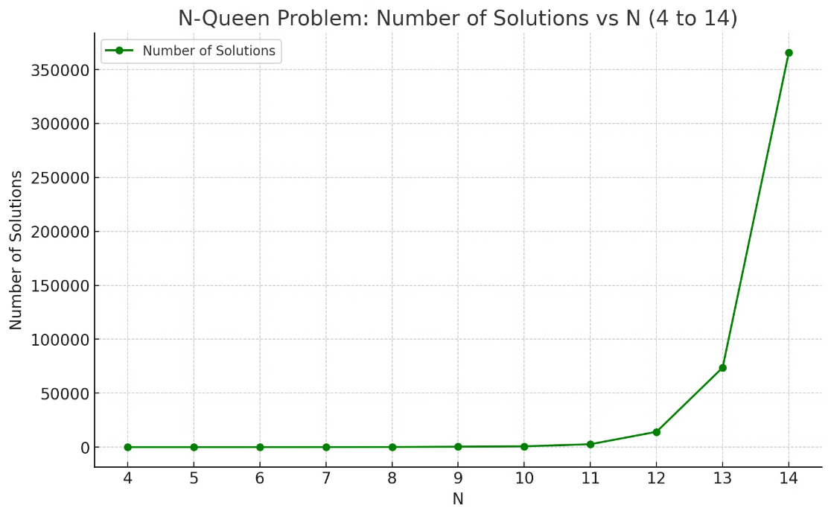
No Of Solution Vs N

Slide 11
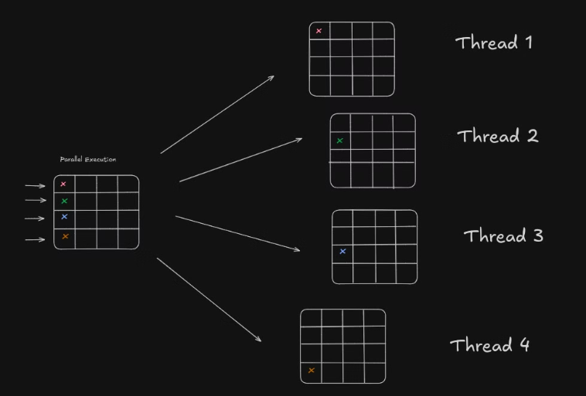
Methodology For Parallel Execution
1) Row-based Parallel Task Execution
Parallel Exploration: Each thread independently places a queen in a different column of the first row and explores valid configurations in subsequent rows, dividing the problem into smaller, concurrent tasks.
Improved Efficiency: Parallel threads explore multiple queen placements simultaneously, significantly reducing search time, especially for larger N-Queens boards.

Slide 12
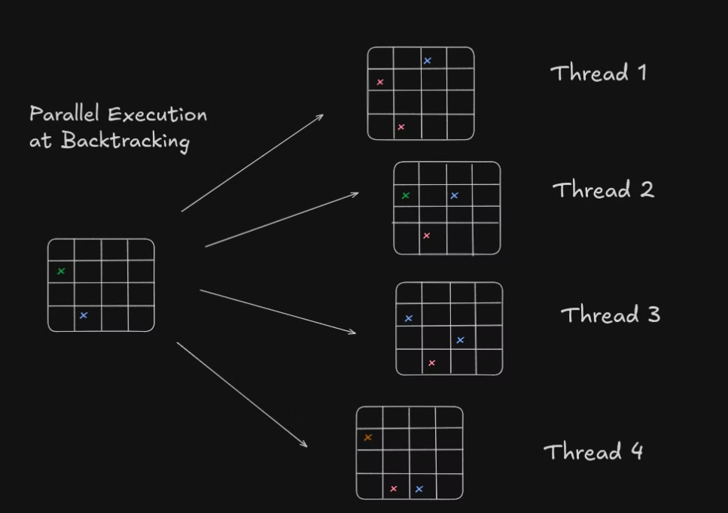
Methodology For Parallel Execution
2) Task Parallelism in Backtracking

Slide 13
Reference
An Optimized MPI-based Approach for Solving the N-Queens Problem
https://ieeexplore.ieee.org/document/6362958
Parallel Programming: N-Queens Problem on GeeksforGeeks:
https://www.geeksforgeeks.org/problems/n-queen-problem0315/1
Parallel N-Queens Problem on Stack Overflow:
https://stackoverflow.com/questions/19078635/optimizing-n-queen-with-openmp
Parallel N-Queens Solver on GitHub:
https://github.com/dwave-examples/n-queens

